Slide 1
^{BOX LAYOUT}
Presentation By: Nabin Dahal

Slide 2
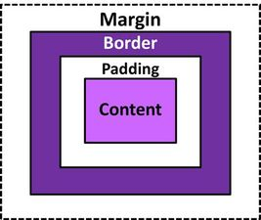
CSS BOX MODEL
It wraps every HTML element.
It consists of margin, borders, padding, and the actual content.

Slide 3
Margin
consists of the area between the boundary and the edge of the border
Transparent
Used for separating elements from neighbors.
Determined by margin left right top bottom.

Slide 4
Border
Area between box padding and margin.
Allows to set style, color, and width
Also used to cover the content

Slide 5
Padding
The space around the content area and within the border box.
Used to create space around the elements, inside any define border.

Slide 6
Content
Content area consists of text, images, or the other media .
Used for displaying the text , image, etc.
Displayed portion in box model

Slide 7
Height and width element
The height and width properties are used to set he height and width of area inside the padding ,border, margin.
Auto
Defined in px, cm %.

